Slide 1
UI Flows in action!
Robotic process automation for Power Automate

Slide 2








Hi! I am Jenkins NS
Founder & Director @JPOWER4
15+ Years of experience
Microsoft Most Valuable Professional (MVP)
Power Platform Specialist
Senior Consultant
International Speaker
Trainer
Love to solve problems
@jenkinsns
http://www.jpower4.com

Slide 3
Solution: Power Automate + AI Builder + UI flows
Power Automate for digital
process orchestration
AI Builder (OCR) for
data capture
UI Flows for automated
data entry

Slide 4





Robotic Process Automation (RPA)
Power Automate is an intelligent digital
process automation (DPA) service

Slide 5

Bridging Automation Across API and non-API based apps
Non-API apps
Power Automate bridges
automation across systems
Modern Systems

Slide 6



Introducing RPA with Power Automate:
Automate Apps with Robotic Process Automation (RPA) Capabilities
Record the Task
Automate the Task
Execute the Task

Slide 7
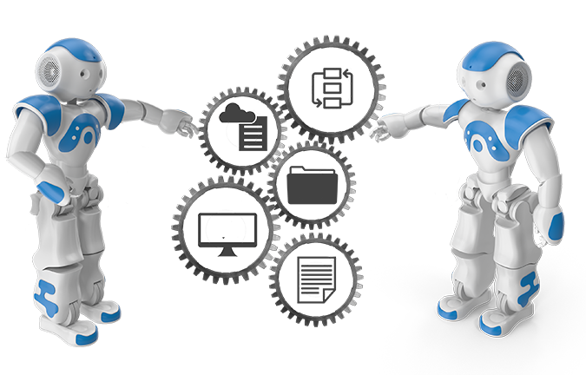
When and why should you use UI Flows?
The target app has no API
The scenario requires to use the user interface
UI Flows (or RPA) for automation is fragile
Changes to the interface can break your flow
Consider creating API’s / Upgrade your apps

Slide 8

Power Automate With Attended and Unattended RPA
Automation whether you’re logged in or not
Attended
Unattended
Interactive acceleration
Human initiated Logged in
High volume back-end processes
Runs automatically
Can log into system or machine
Notes:
https://docs.microsoft.com/en-us/power-automate/ui-flows/run-ui-flow

Slide 9
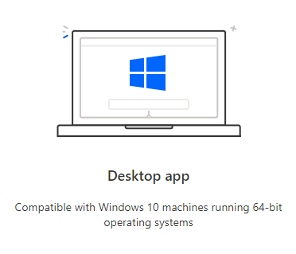
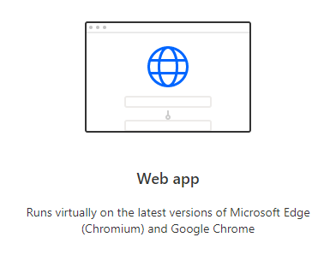
Power Automate for desktop apps or web apps

Slide 10
Prerequisites
A device that runs Windows 10 Pro, Windows Server 2016, or Windows Server 2019.
The Microsoft Edge or Google Chrome browser.
An environment with a Common Data Service database.
A supported keyboard attached.
Notes:
https://docs.microsoft.com/en-us/power-automate/ui-flows/setup

Slide 11
Limitations
You must have the latest versions of each components to record, test, or run UI flows.
The following are not supported:
Windows 10 Home installations are not supported.
Desktop UI Flows
Multiple monitors
Double click, mouse hover, touch/pen input
Interactions on Windows (File explorer, startup menu, task bar, etc.)
Web UI Flows
Right click
User session information (e.g.: cookies) will not be reused during playback. You will have to edit the script to embed sign in information when required by websites.#
You'll find feature-specific limitations included in the documentation for each feature

Slide 12
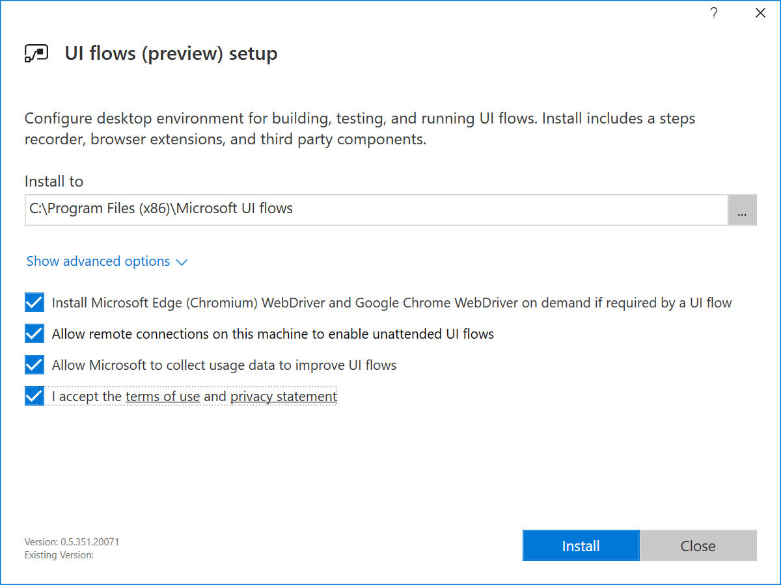
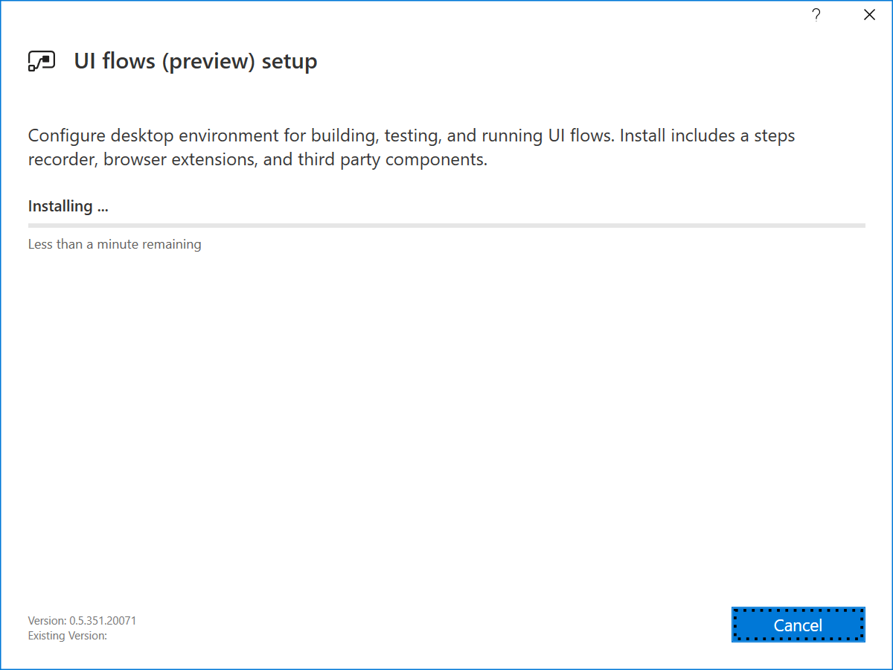
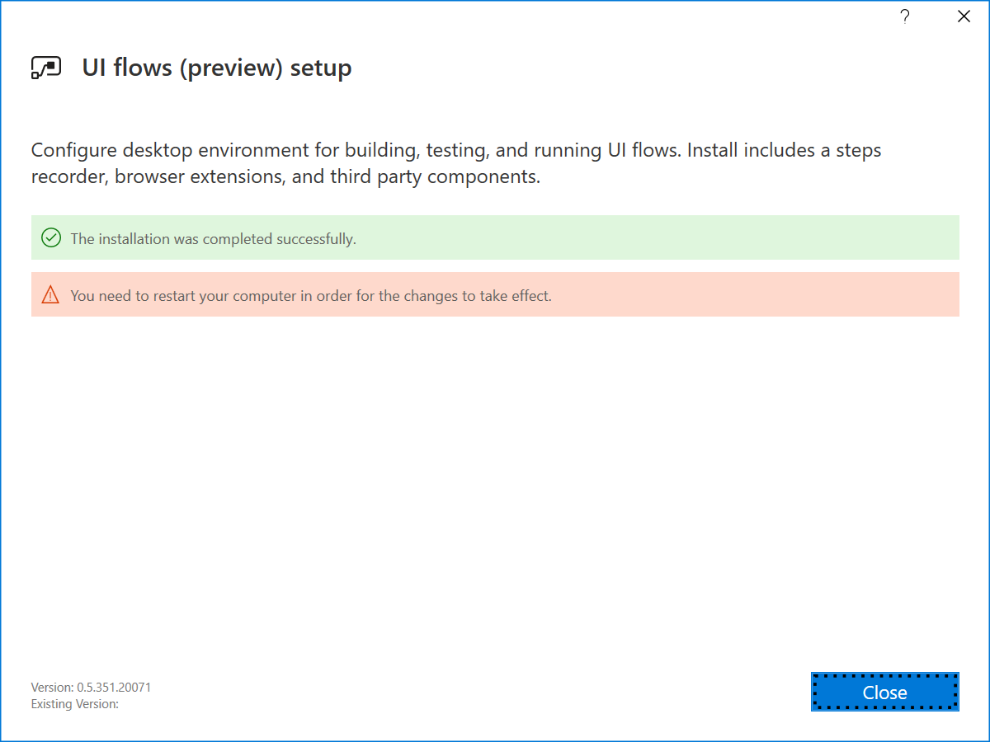
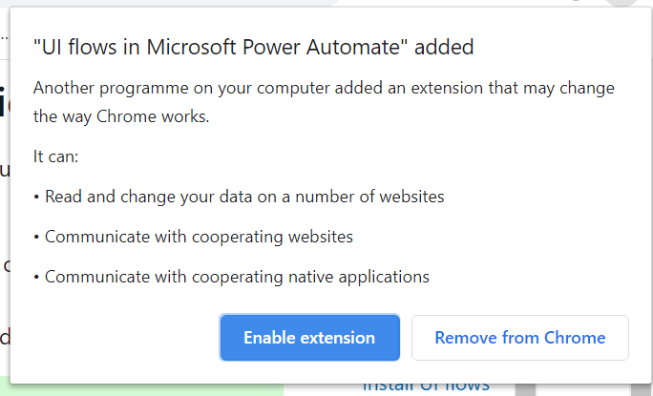
Setup Environment
Install UI flows on your device
Download the UI flows installer
Activate the UI flows browser extension
Notes:
https://docs.microsoft.com/en-us/power-automate/ui-flows/setup

Slide 13
Setup Environment
Install Selenium IDE to automate Web applications
Download and install the Selenium IDE for the next version of Microsoft Edge or Google Chrome.
Install the on-premises data gateway
Recommend
An 8-core CPU
8 GB of memory
A 64-bit version of Windows Server 2012 R2 or later
Solid state drive (SSD) storage for spooling.
Download and install a standard gateway
Notes:
https://docs.microsoft.com/en-gb/data-integration/gateway/service-gateway-install

Slide 14
Demo

Slide 15
jenkinsns@gmail.com jenkinsns@jpower4.com @jenkinsns – Twitter https://github.com/jenkinsns/PowerAutomate http://www.jenkinsblogs.com http://www.jpower4.com

